Slide 1
ORACLE DATABASE VAULT INTRODUCTION & EXAMPLE
Nguyen Duc Tuyen
System Engineer, SI Center

Slide 2
Agenda
Overview
Installation
Securing Data Example
Backups

Slide 3
Overview
Why Oracle Database Vault?
Don’t trust the DBA
Separation of duties
Notes:
Why would you need to install Database Vault?
Don’t trust the DBA – then time to get a new DBA
Regulatory compliance – can’t really get around this one.
Separation of duties – remove single point of failure (ie. No one person can do everything).

Slide 4
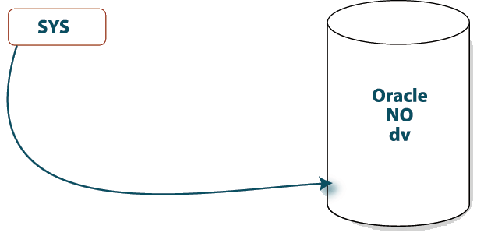
Separation of duties
connect / as sysdba
create user david ...
grant dba to david;
select * from scott.emp;
Notes:
If you’re a DBA here’s some things you can do now.
connect / as sysdba
create user david …
grant dba to david;
select * from scott.emp;

Slide 5
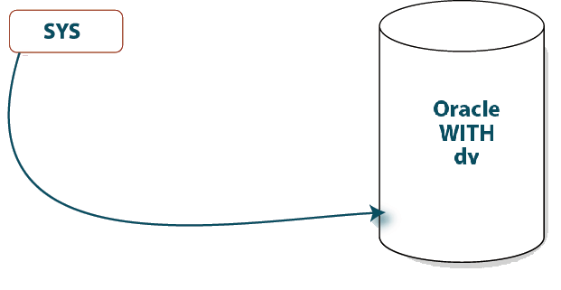

Separation of duties
connect / as sysdba
create user david ...
grant dba to david;
select * from scott.emp;
Notes:
Once Database Vault has been installed, you cannot do any of these things (except maybe #4 depending whether the scott schema has been locked down or not by the Database Vault Owner).

Slide 6
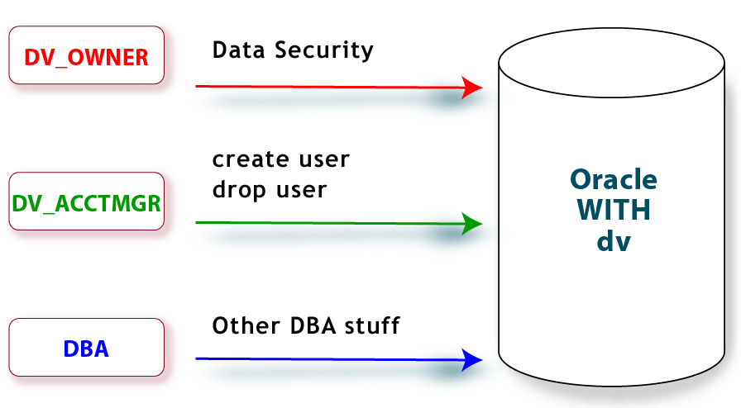
Separation of duties
Notes:
The key to Separation of Duties is that no one single ROLE can do everything.
The DV_OWNER role can only do data security.
The DV_ADMIN role can only create/drop users
A DBA role can do anything EXCEPT data security and create/drop users – and is subject to any data security setup by the DV_OWNER role.

Slide 7
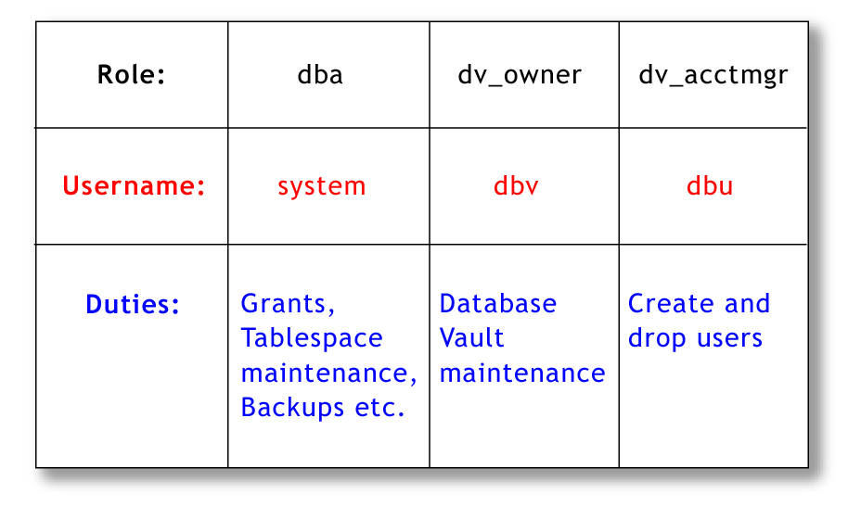
Separation of duties
Notes:
Here’s how it works in practice.
When you install Oracle Database Vault, you get three roles.
During the install, you need to specify which users will be initially setup with those roles.
After the install, you can setup multiple users with each of these roles, however, you would not grant all 3 roles to the one user (it kind of defeats the purpose for separation of duties).

Slide 8
Oracle Database Vault Components
Oracle Database Vault Access Control Components
Oracle Database Vault Administrator (DVA)
Oracle Database Vault Configuration Assistant (DVCA)
Oracle Database Vault DVSYS and DVF Schemas
Oracle Database Vault PL/SQL Interfaces and Packages
Oracle Database Vault and Oracle Label Security PL/SQL APIs
Oracle Database Vault Reporting and Monitoring Tools

Slide 9
Database Vault Access Component
Realms
Command rules
Factors
Rule sets
Secure application roles
Notes:
Realms. A realm is a functional grouping of database schemas, objects, and roles that must be secured. For example, you can group a set of schemas, objects, and roles that are related to accounting, sales, or human resources. After you have grouped these into a realm, you can use the realm to control the use of system privileges to specific accounts or roles.
Command rules. A command rule is a special rule that you can create to control how users can execute almost any SQL statement, including SELECT,ALTER SYSTEM, database definition language (DDL), and data manipulation language (DML) statements.
Factors. A factor is a named variable or attribute, such as a user location, database IP address, or session user, which Oracle Database Vault can recognize and secure. You can use factors for activities such as authorizing database accounts to connect to the database or creating filtering logic to restrict the visibility and manageability of data. Each factor can have one or more identities. An identity is the actual value of a factor. A factor can have several identities depending on the factor retrieval method or its identity mapping logic.
Rule sets. A rule set is a collection of one or more rules that you can associate with a realm authorization, command rule, factor assignment, or secure application role. The rule set evaluates to true or false based on the evaluation of each rule it contains and the evaluation type (All True or Any True). The rule within a rule set is a PL/SQL expression that evaluates to true or false. You can have the same rule in multiple rule sets.
Secure application roles. A secure application role is a special Oracle Database role that can be enabled based on the evaluation of an Oracle Database Vault rule set.

Slide 10
Agenda
Overview
Installation
Securing Data Example
Backups

Slide 11
Prerequisites
Oracle 10.2.0.3
1024 MB of Physical RAM
Swap space (1.5 times RAM)
400 MB in /tmp
270 MB for database vault binaries
10 MB additional for database files
Notes:
Note: swap space requirements decrease with larger memory configurations.
See the Oracle Database Vault documentation for more details.

Slide 12
Prerequisites
Installation
Assumes one instance per Oracle home
But can support more
Notes:
During installation it will only patch a single instance.
Others would need to be patched manually.

Slide 13
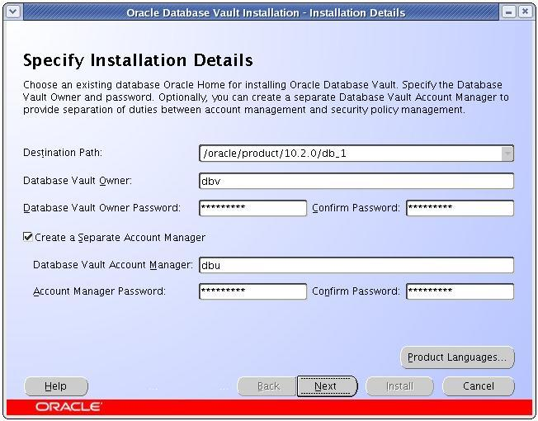
Installation
Notes:
When you run the installer, here’s the first screen that comes up.

Slide 14
Installation
User to receive DV_OWNER role
Notes:
This is where you enter the usernames that will be created with the DV_OWNER and DV_ACCTMGR roles.

Slide 15
Installation
Passwords must have alpha, numeric & special
Notes:
Passwords can be changed later and it’s only the Oracle installer that enforces the “alpha/numeric/special” password strength.
For some reason “$” is not considered a special character.

Slide 16
Installation
Notes:
As you can see by the checkbox, this user is optional.

Slide 17
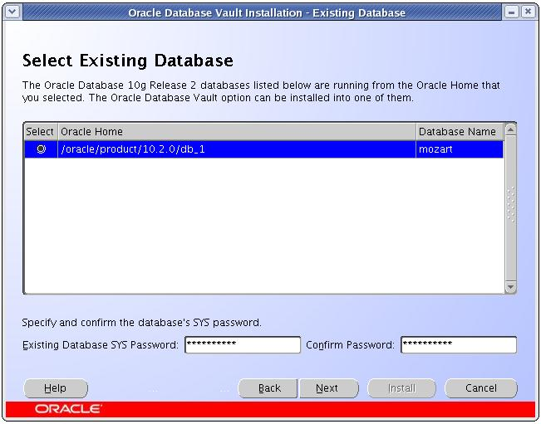
Installation
Notes:
The current SYS password is required.

Slide 18
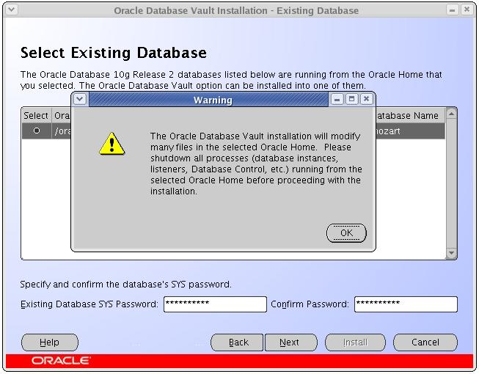
Installation
Notes:
A warning to shutdown everything first.

Slide 19
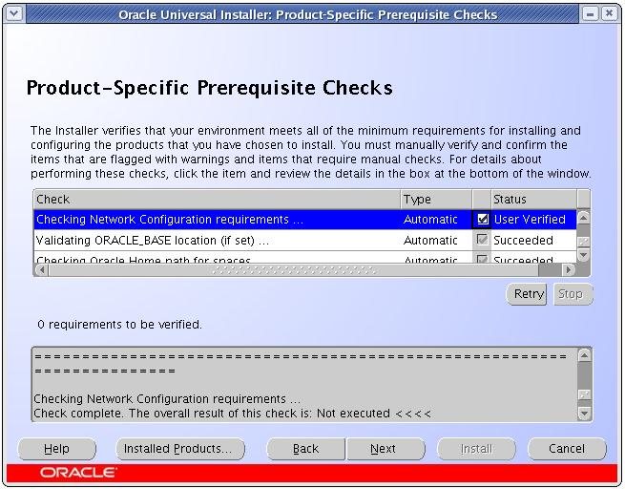
Installation
Notes:
The network configuration requirements must be checked manually.

Slide 20
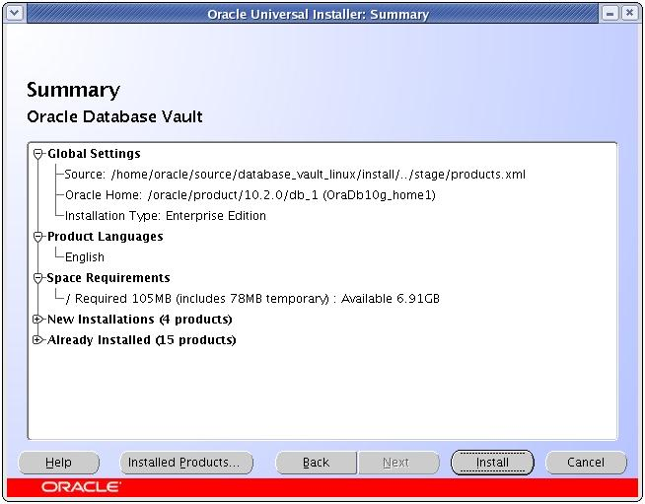
Installation
Notes:
They you get a typical installation summary.

Slide 21
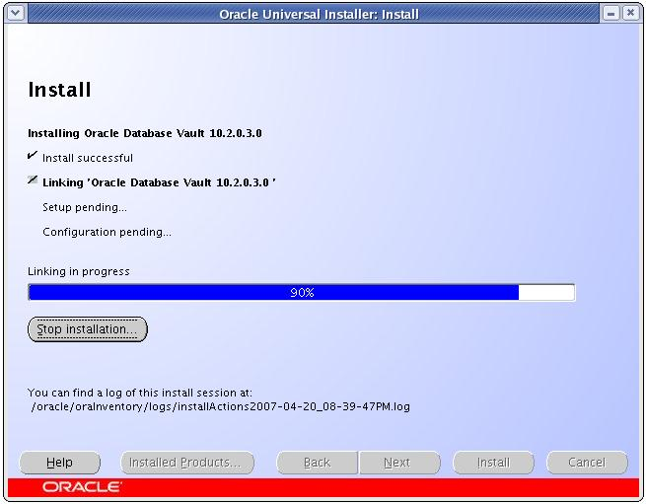
Installation
Notes:
It’s a pretty standard install really.

Slide 22
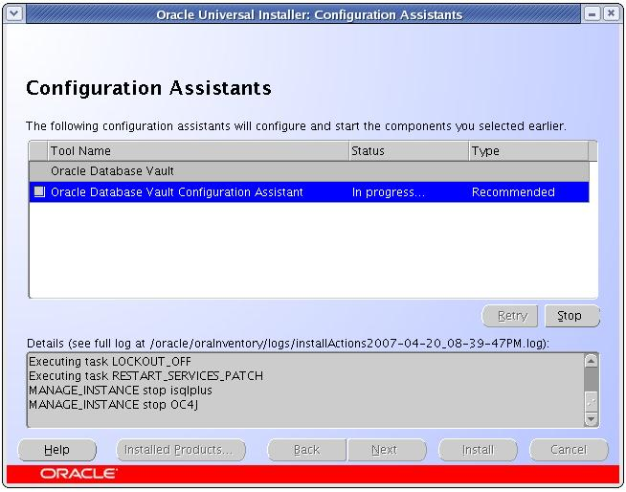
Installation
Notes:
The configuration assistant is fully automatic – nothing to do but sit back and wait for it to finish.

Slide 23
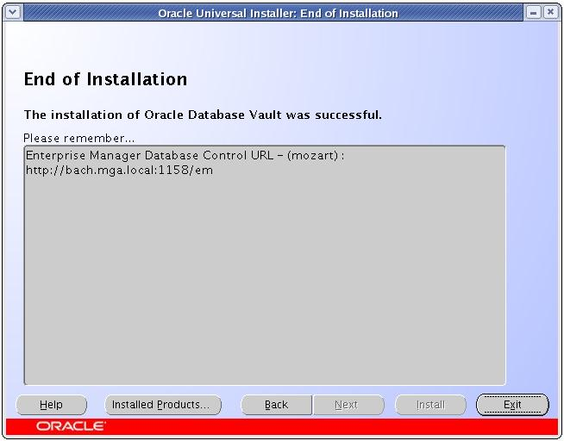
Installation
Notes:
A final note and we’re done.

Slide 24
Agenda
Overview
Installation
Securing Data Example
Backups

Slide 25
Securing Some Data
$ sqlplus system/manager
SQL> select * from scott.emp;
...
14 rows selected.
SQL>
Notes:
First we login as system and select the data from SCOTT.EMP
No problem – 14 rows selected.

Slide 26
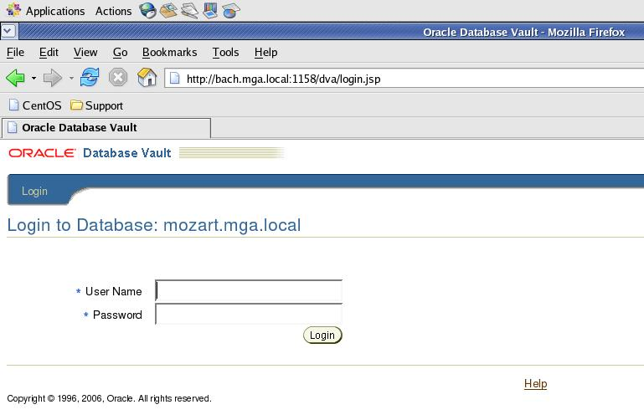
Securing Some Data
Notes:
Now we start the Database Vault Administrator
Type the URL into your browser…

Slide 27
Securing Some Data
Notes:
Now we can login.
In this demo, the username is DBV and the password is MANAGER.

Slide 28
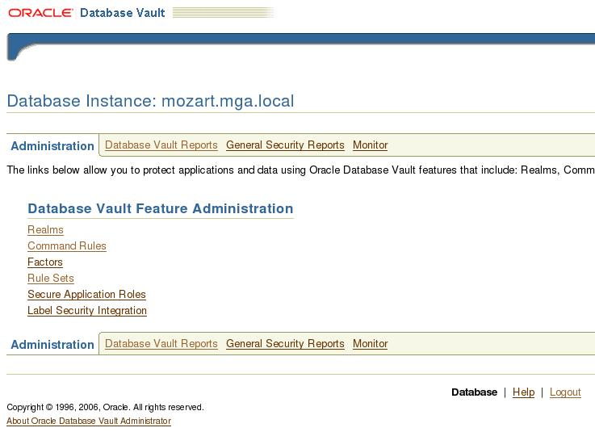
Securing Some Data
Notes:
Once we have logged in, this is the Administrator menu.
To secure some data, we need to create a realm.

Slide 29
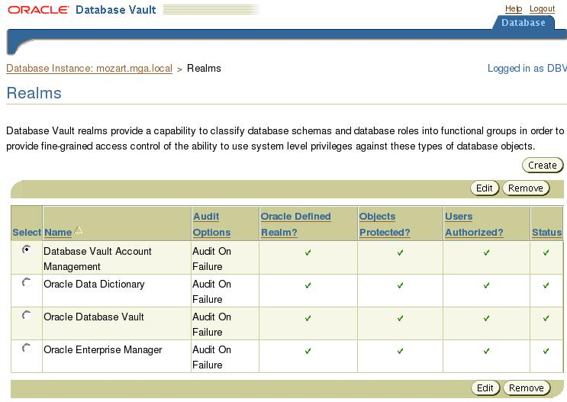
Securing Some Data
Notes:
By default we have 4 realms created already.
Don’t touch these as they are the default ones created when we installed Database Vault.
To secure the SCOTT schema, we create a new realm.

Slide 30
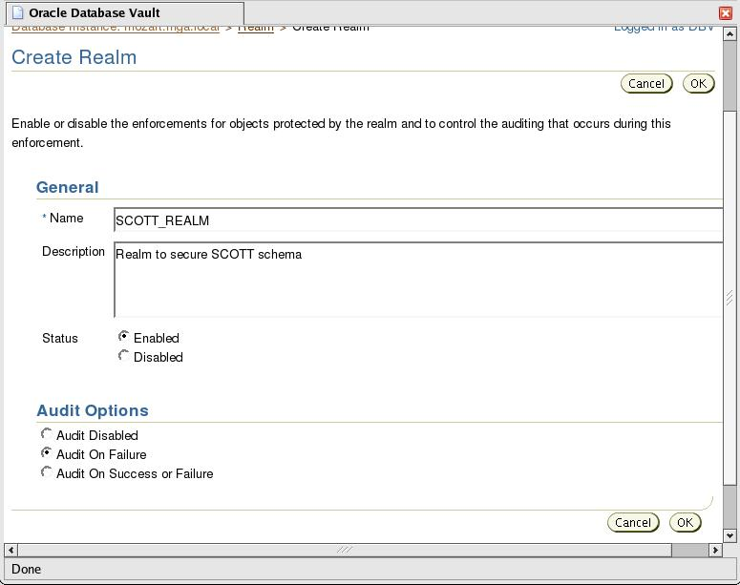
Securing Some Data
Notes:
A Realm has a name, Description, Status and Audit options.
There are no child rows at this stage (ie. Secured objects or authorizations).
We must create the parent row first.

Slide 31
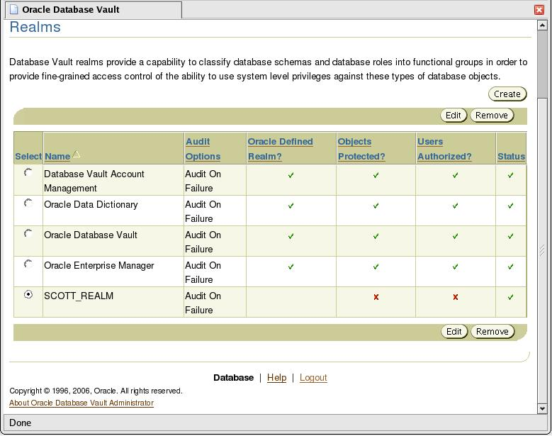
Securing Some Data
Notes:
So now we have a SCOTT_REALM.
It contains no objects or authorizations (as shown by the red X in the relevant columns)
We need to edit the realm to add them in.

Slide 32
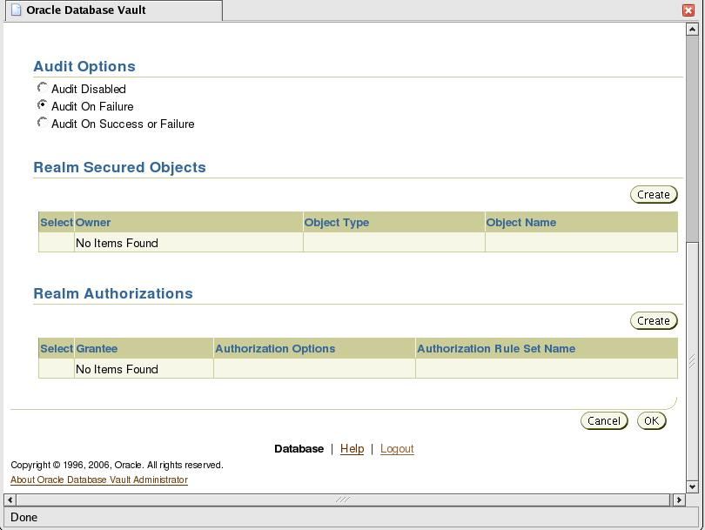
Securing Some Data
Notes:
Once we are editing the realm, we scroll down to the secured objects.
There are none yet – so click on the Create button.

Slide 33
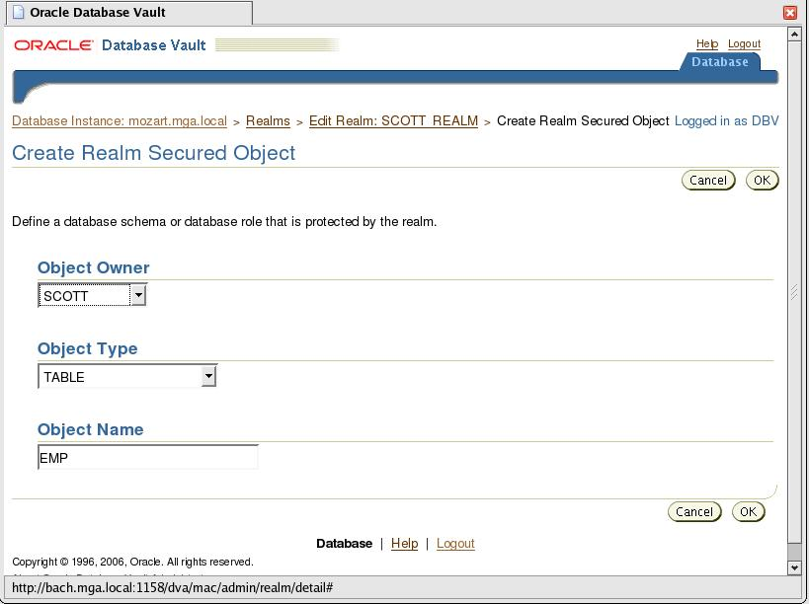
Securing Some Data
Notes:
The objects are listed by owner, type and name.
Wildcards (i.e. the percent sign) are also permitted for the type and name.
Then click OK.

Slide 34
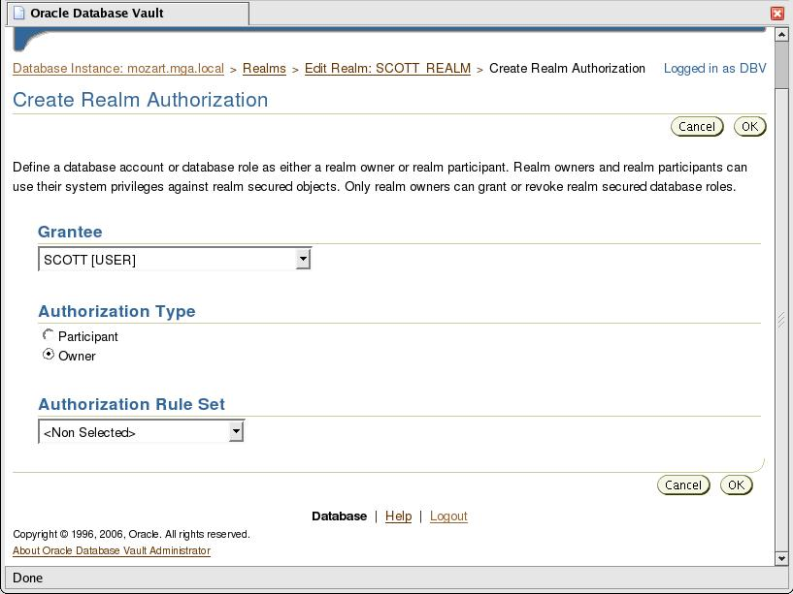
Securing Some Data
Notes:
We setup SCOTT as an owner of this realm. (You are allowed more than one owner of a realm.)
Leave the rule set as “Non Selected”.

Slide 35
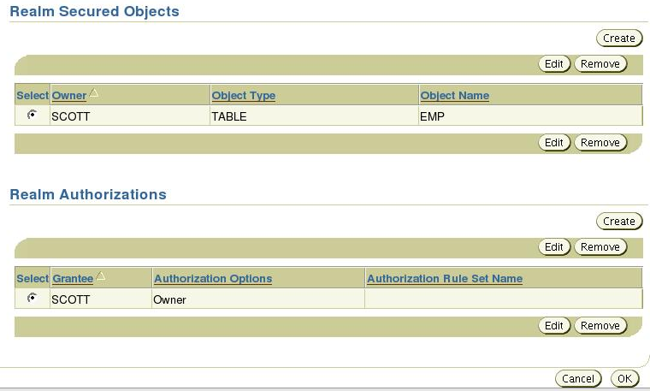
Securing Some Data
Notes:
Now we have the EMP table secured and SCOTT as an owner of the realm.
Click OK to finish editing the realm.

Slide 36
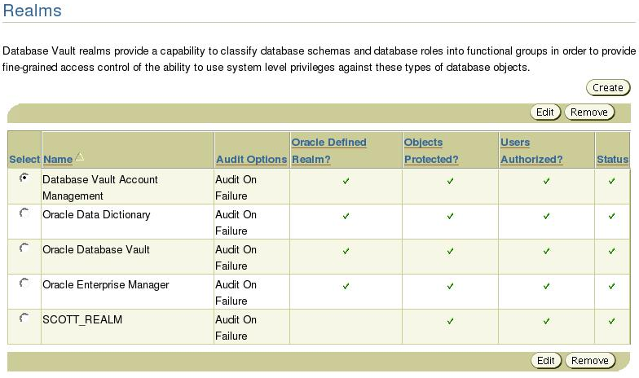
Securing Some Data
Notes:
So now we see the SCOTT_REALM has objects protected and users authorized.
Let’s go back to our sqlplus session (connected as SYSTEM) and see what happens.

Slide 37
Securing Some Data
SQL> select * from scott.emp;
select * from scott.emp
*
ERROR at line 1:
ORA-01031: Insufficient Privileges
SQL>
Notes:
If we rerun the same SQL from the same session, without connecting again, our SQL fails.
The realm now comes into play and the SELECT ANY TABLE privilege is no longer sufficient to gain access to SCOTT.EMP.

Slide 38
Securing Some Data
SQL> select * from scott.dept;
DEPTNO DNAME LOC
---------- -------------- --------
10 ACCOUNTING NEW YORK
20 RESEARCH DALLAS
30 SALES CHICAGO
40 OPERATIONS BOSTON
SQL>
Notes:
However, SCOTT.DEPT is not secured by the realm, so we can still select from it.

Slide 39
Agenda
Overview
Installation
Securing Data Example
Backups
Notes:
Let’s have a quick look at backups.

Slide 40
Backups
Impact of Backups
Export/Import
Datapump
RMAN
Notes:
The thing we really need to know is how to backup a database when Database Vault is installed.

Slide 41
Backups
Export/Import
Export can be done with many ORA-01031
Import object protected by Database Vault will fail
Notes:
Export actually worked – but unless you read the logs, would not realize it was useless until you needed to do an import.

Slide 42
Backups
Datapump
Requires Database Vault-specific authorization
Notes:
Export actually worked – but unless you read the logs, would not realize it was useless until you needed to do an import.

Slide 43
Backups
RMAN
Requires SYSDBA access
May need to hardcode SYS password or use wallet
Notes:
RMAN was successful – but required a login as SYSDBA.
So you will need to recreate the password file with NOSYSDBA=N
There is a useful wallet example in the Admin Documentation that works okay.

Slide 44


